Slide 1

NYC Crime Analytics:
Retrieval System
APAN 5400 Term Project
Group 2:
Aaman Basra, Pallavi Gudipati, Siqi Liu,
Sachin Otsuka Arjun, Jui-Chen Pu, Lanqi Zhang
Notes:
Shirley

Slide 2
1. Background & Definition
APAN5400
Background
Objective
New York City’s crime-complaint file is huge and messy. Data are in big csv files that analysts can’t drill into patterns or get alerts without first spending hours on heavy ETL work.
Until that raw trove is cleaned, structured, and streamed into an analytics layer, critical insights on emerging hot spots and resource gaps remain buried.
To address this, we intend to create a holistic information retrieval system through an ETL pipeline and create a data warehouse indicating crime occurrences with details.
It will also help identify crime rates and resource allocation amongst over/understaffed precincts.
Current Challenges
Target Audience
Data overload
Manual limitations
Lack of real-time insights
Privacy/Ethics
Residents & Commuters
Precinct & Patrol Commanders
Mayor’s Office & City Council
Community Boards & Neighborhood Associations
Notes:
shirley

Slide 3
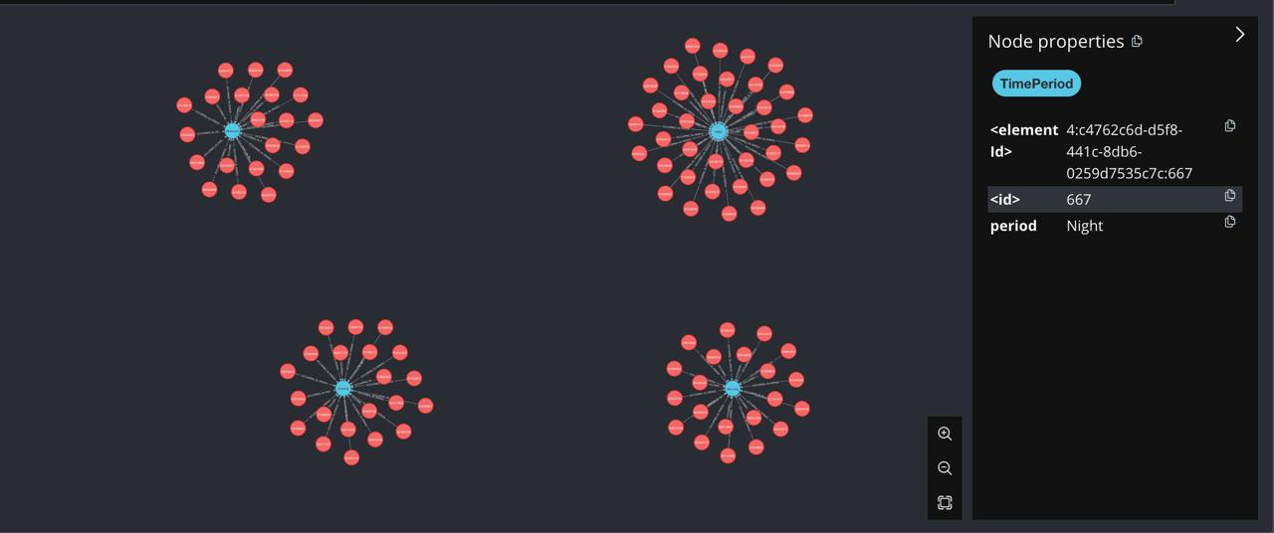
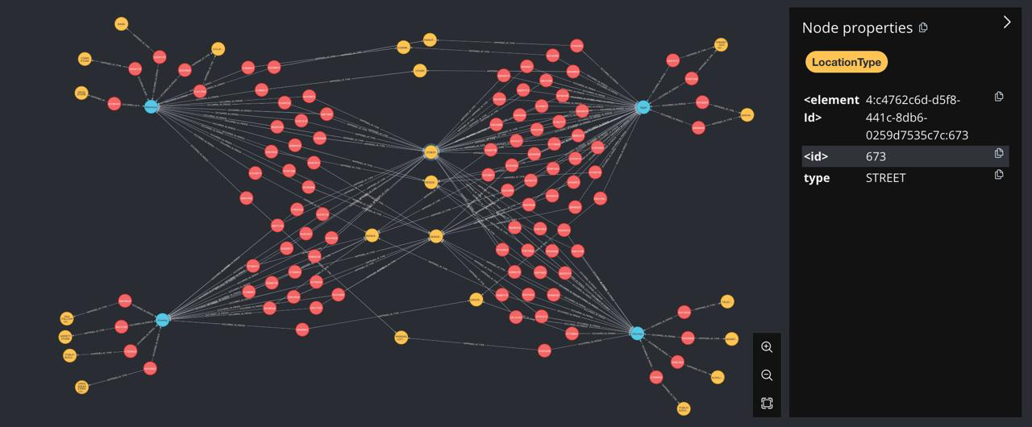
2. Data Source Procurement
APAN5400
Solution
An info retrieval analytics system built on MongoDB/AWS, capable of ingesting, storing, analysing, and visualizing data at scale.
Data Source
Data Source: NYC Open Data
Dataset Size: 3.03 GB
Data Type: Historical NYC crime data including crime type, location, time, suspect, and victim information
Content: Dataset of 35 variables and 8.91 million rows are maintained and updated regularly. The data spans from November 16, 2016 to December 31, 2024.
Procurement
Procurement: Publicly available datasets provided by NYPD
Format: CSV files
Storage: MongoDB, PostgreSQL for raw and processed data
Notes:
Aaman

Slide 4






3. Rationale For Technologies
APAN5400
Component | Technology | Rationale
Data Tidying | Python Spark | Spark’s distributed computing ensures fast, scalable processing, seamless technology integration, and flexibility for both batch and real-time analysis.
Database | MongoDB/PostgreSQL | NoSQL structure allows flexible schema design, ideal for heterogeneous or sparse crime records. Seamless integration with Python and Flask/HTML.
Visualization | Neo4j | Uses a relationship based model with nodes and relationships. Perfect to visually explore various relationships in our data in an efficient manner.
App | Flask/HTML | It allows seamless integration with our backend (PySpark and Neo4j), and provides a clean, user-friendly interface ideal for visualizing data and sharing insights.
Spark
PostgreSQL
MongoDB
neo4j
Flask/HTML
Notes:
Sachin

Slide 5
Spark and Neo4j
APAN5400
Used PySpark, the Python interface for Apache Spark:
Distributed processing of 8M+ crime records during ETL
Large-scale data cleaning (e.g., invalid dates like year 1015)
Standardized fields (dates, nulls, categories) for analytics
Significantly faster than Pandas due to parallel processing
Output sent to PostgreSQL (cleaned) and MongoDB (raw)
Used For:
Model complex relationships in the crime dataset
Build graphs with nodes like Crime, Time Period, LocationType, and Victim.
Explore patterns, such as high-risk time periods and locations
Reveal hidden structures not easily seen in tabular data.
Notes:
Pallavi + Yolanda

Slide 6

MongoDB/Postgre and Flask/HTML
APAN5400
Used For:
Interactive map using latitude and longitude filtering by borough and offense keyword
Filterable table of complaint records
Pie chart showing Top 5 Offense Types
Searchable frontend UI
1000 rows were fetched
Used For:
Analytical charts/graphs using:
Crime count by borough
Crime categories
Top 5 crime types
Crime trends by date
Visualized 10,000 rows using Plotly (bar, pie, line charts)
Used for:
We made a single route at @app.route("/") that reads four URL parameters: borough, offense, chart and page(for our 10-row table pagination).
Querying MongoDB (crime points + paginated table rows) and PostgreSQL (analytics charts)
Building and embedding the Folium map and Pie‐chart data in Python and displaying a searchable, paginated table of crime records
Rendering all of that into one HTML template
Notes:
Aaman + Sachin

Slide 7




4. Data Quality Dimensions
APAN5400
Accuracy
Completeness/Consistency
The dataset has no apparent formatting errors other than some minor issues such as years out of range (e.g. year 1015), which were corrected during cleaning.
The dataset is structurally sound and complete.
Core variables to be investigated (e.g. complaint info, location, time) are highly complete. Columns with high missingness (e.g. CMPLNT_TO_DT, TRANSIT_DISTRICT) either have complementary information or are not taken into account.
Timeliness
Validity
The dataset includes historical data from 2006 to 2023 but does not include real-time updates, which is acceptable for our current goals.
We standardized date/time fields to ensure format consistency. All other values conform to expected types.
Notes:
William

Slide 8
APAN5400
DEMO
Notes:
William

Slide 9



5. Scalability, Justification, Benefits
APAN5400
Scalability
Python Spark: supports distributed processing across large-scale data clusters
MongoDB/PostgreSQL: supports horizontal scaling via sharding; supports vertical scaling and read replicas for load distribution.
Neo4j: supports clustering for large graph datasets
Flask/HTML: Flask can be horizontally scaled using containers and load balancers, making it suitable for cloud deployment. HTML interfaces are lightweight and cacheable.
All technologies support scalable deployments as data volume increase.
Licensing:
NYC Open Data: NYPD Complaint Data Historic
Performance & Privacy:
Respond quickly and stably;
No personal data, 100% compliance with relevant data management policies and adhere to local privacy laws (NYC’s Shield Law, CCPA as applicable)
Notes:
Shirley

Slide 10
6. Cost Implications
APAN5400
Cost under current scale
Server | Cost per Month AWS | Cost per Month GCP | Description
EC2 | $60.74 | ~$7.99 | t3.large (2 vCPU, 8 GiB RAM), shared tenancy, on-demand, basic web app hosting
S3 | $0.80 | ~$0.11 | 4.48GB storage, basic S3 operations
DynamoDB | $7.38 | ~$4.85 | Standard table, on-demand capacity
Lambda | $0.00 | $0.03 | ETL jobs, Free Tier
API Gateway (REST API) | $3.50 | $0.00 | 1M requests per month
RDS (PostgreSQL) | $16.39 | $56.44 | db.t3.micro, 20GB SSD, Single-AZ
Total | $38.14
Cost Projection (Optional Future Scale)
Server | Cost per Month | Description
EC2 (m5.xlarge) | ~$93.33 | m5.xlarge (4 vCPU, 16 GiB RAM), reserved pricing, for higher load
S3 (Storage growth) | ~$2.00 | Additional datasets
DynamoDB (Scaling) | ~$15-20 | Higher traffic load
API Gateway (Scaling) | ~$5-8 | Increased API calls
RDS (Larger DB) | ~$30-35 | More concurrent users
Total Projection | ~$85-105
Notes:
William

Slide 11
7. Conclusion and Recommendations
APAN5400
Conclusion
Future Recommendations
We successfully designed and deployed an end-to-end NYC crime data retrieval system.
Built a ETL pipeline using Spark to clean, validate, and structure over 8.9 million records.
Used MongoDB for raw data backup and PostgreSQL for structured analytics-ready data.
Developed an interactive Flask/html-based dashboard enabling fast, filtered access to historical crime trends.
Explored Neo4j for relationship modeling (e.g., suspect-crime-location graphs)
Real-Time Crime Monitoring
Integrate Kafka or other real-time data streams to detect emerging crime hotspots instantly.
Predictive Modeling
Use machine learning (e.g., time-series forecasting, anomaly detection) to predict crime trends and recommend resource allocation.
Enhanced UI/UX
Add user-configurable geospatial filters and custom precinct-level alerts in the dashboard while keeping it user-friendly.
Notes:
Pallavi

